Slide 1
DIGITAL PORTFOLIO
STUDENT NAME :ARUL PRAKASH K
REGISTER NO AND NM ID :24131040500121005and 6D70BFD130EC601A0164965DAF46D5DD
DEPARTMENT : bachelor of computer application (B.C.A)
COLLEGE : JAWAHAR SCIENCE COLLEGE

Slide 2

PROJECT TITLE
DIGITAL PORTFOLIO

Slide 3
AGENTA
Problem statement Project overview
End Users
Tools And Technologies Portfolio Design And Layout Features And Functionality Results And Screenshots
Github Link

Slide 4

PROBLEM STATEMENT
In today’s Era Digital Techniques Alone Are Not Sufficient To Showcase Students Skills Set And Knowledge , This Helps To Show There Skills and Other Activities

Slide 5

PROJECT OVERVIEW
Portfolio Contain About My Project , Skills , Contact
It Contain About Project Work , My Skills and You Can Also Contact Me
Main Idea : Personal Showcase , And Project Details

Slide 6
WHO ARE THE END USERS
STUDENTS ( Academic Project , Resumes)
PROFESSIONAL( To Show There Experience and Achievements) FREELANCERS ( To Show Clients )
JOB SEEKERS ( To Highlight Experience And Achievements )

Slide 7
PORTFOLIO DESIGN AND LAYOUT
SECTION HOME SKILLS
CONTACT
MOBILE / DESKTOP TABLE PROJECT
DETAILED EXPLANATION

Slide 8
TOOLS AND TECHNIQUES
HTML - structure ( pages , section )
CSS - styling
JAVASCRIPT - Interactivity
Mention Code Editor ( VS Code ) and Hosting platform ( GITHUB Pages )

Slide 9
FEATURES AND FUNCTIONALITY
Navigation BAR with Smooth Scrolling Image Details / Hyperlink
Interactive Elements – Animations , Background Color Change
Contract Form
Responsive Design

Slide 10
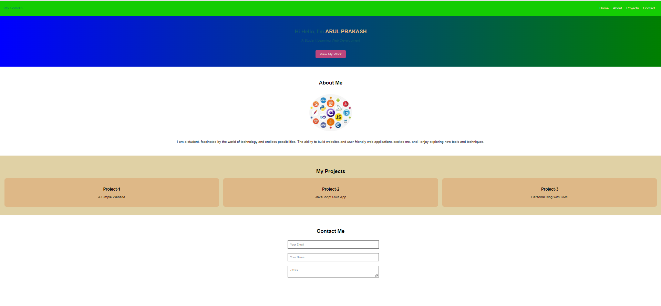
RESULTS AND SCREENSHOTS

